Slide 1
Filtration, Dialysis, and Membranes
Team 7
Amanda Bryant, Isabella Lowinger,
Cal Mesirow, Ryan Higbee, Renad Nakdali

Slide 2
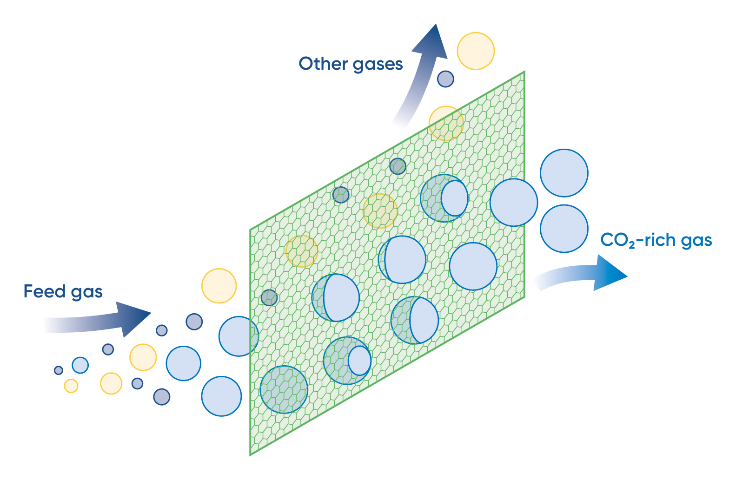
What is it?
"Filtration/dialysis/membranes" describes a collection of separation methods used in chemical engineering that use semi-permeable membranes and mediums to selectively let some molecules through while keeping others out.
AG, A. Membrane separation process. www.andritz.com. https://www.andritz.com/environmental-solutions-en/clean-air-technologies/technologies-clean-air-technologies/decarbonization-clean-air-technologies/membrane-separation-process.
Notes:
Renad

Slide 3

Filtration
Filtration is the process of removing a solid from a liquid or gas through the use of a medium
Cake Filtration is an example of a filtration process where solid particles will accumulate and form a layer on a medium.
Constant Rate Equation:
Where ΔP is the pressure drop in Pa, V is the filtrate volume , μ is the viscosity of the liquid, αav and Rm are constants that are common in fitartion, c is s the dry mass of solids per unit filtrate volume, and A is the cross section of the filtration area
Mahdi, F. M.; Holdich, R. G. Laboratory Cake Filtration Testing Using Constant Rate. Chemical Engineering Research and Design 2013, 91 (6), 1145–1154. https://doi.org/10.1016/j.cherd.2012.11.012
Notes:
Isabella
the constant rate equation is used to analyze the relationship between pressure drop across a filter and the volume of filtrate collected over time
Solids remain ons on the filter layer while liquid flows through
Cake filtration is common in water treatment to potentially remove hydrocarbons which can be found in natural gas.

Slide 4
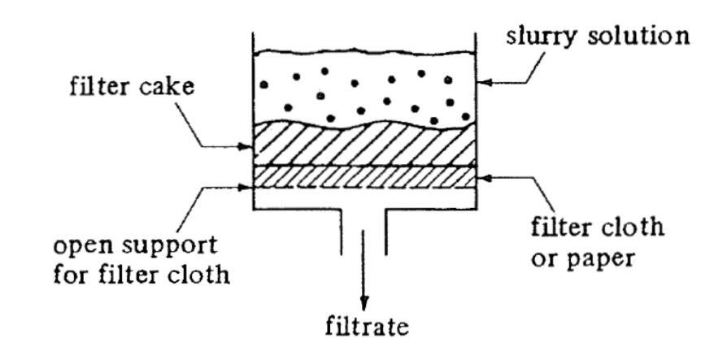
Filtration Cont.
Geankoplis, C. J. Transport Processes and Separation Process Principles (Includes Unit Operations) Fourth Edition; Prentice Hall, 2003.
Notes:
Isabella

Slide 5
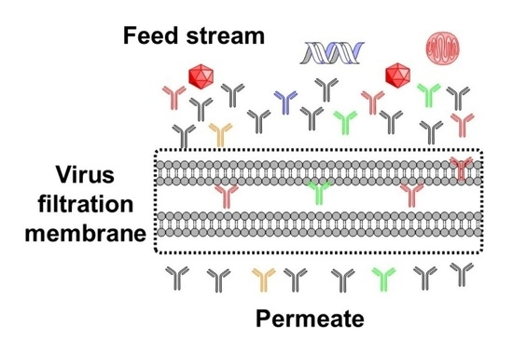
Filtration in Industry
Pharmaceutical manufacturing utilizes filtration to separate viruses from monoclonal antibodies
Size based filtration; viruses can be as small as 18 nm, and antibodies can be as large as 12 nm
Pores are very small; filters are prone to clogging
Isu, S.; Qian, X.; Zydney, A. L.; Wickramasinghe, S. R. Process- and Product-Related Foulants in Virus Filtration. Bioengineering 2022, 9 (4), 155. https://doi.org/10.3390/bioengineering9040155.
Notes:
Renad

Slide 6
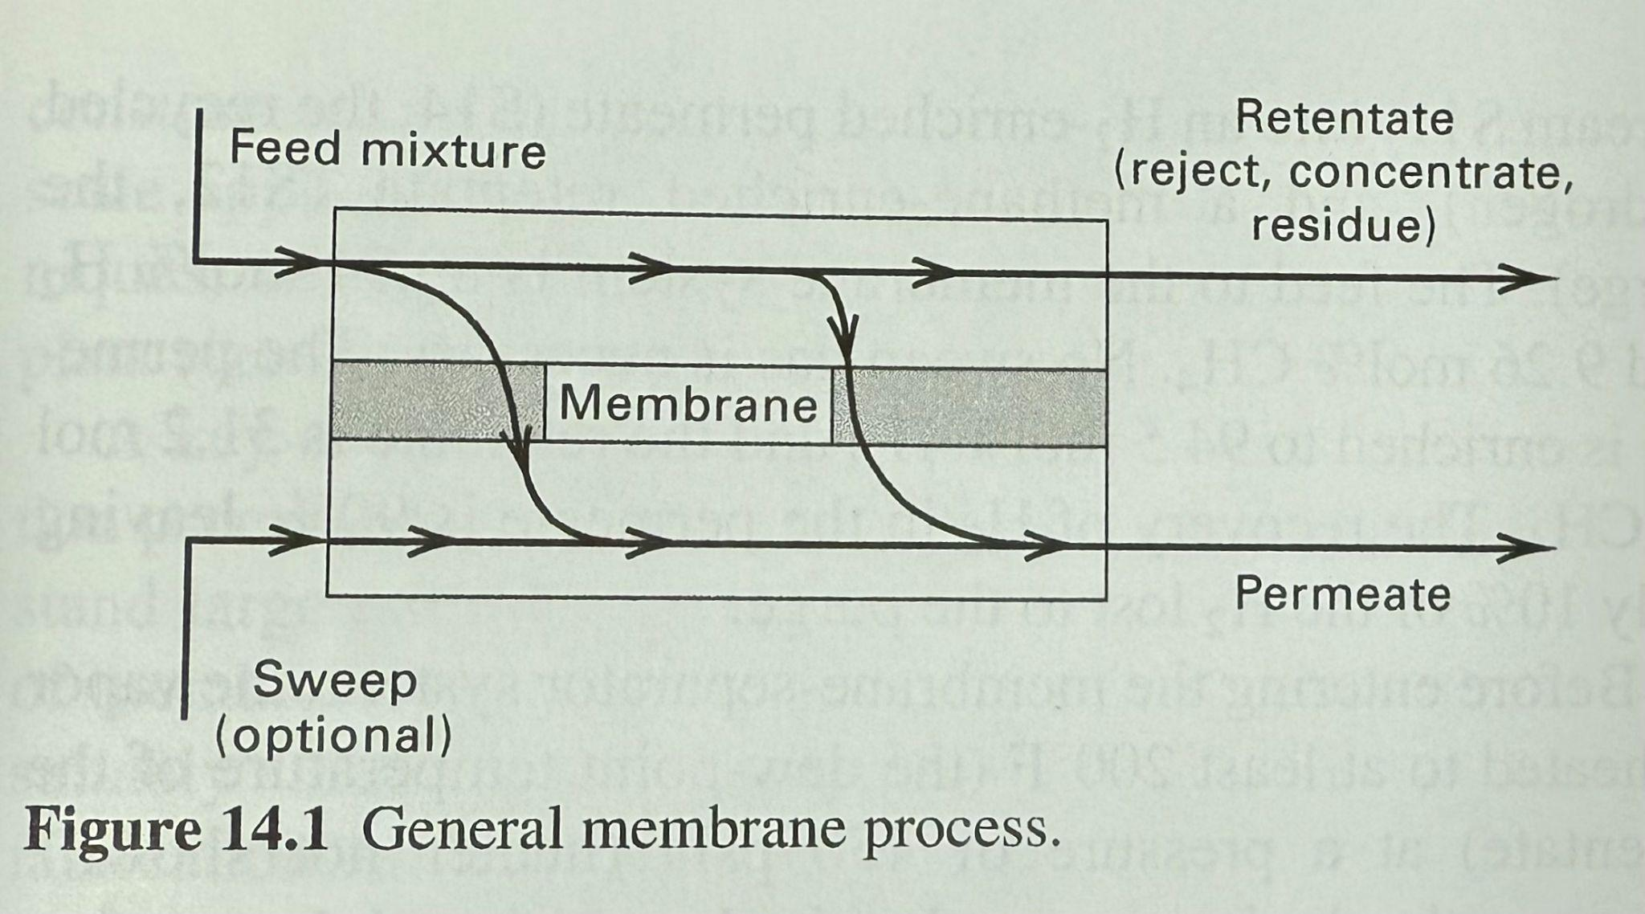
Membrane Separation
Selective separation using semi-permeable membrane
Unlike filtration:
Can separate dissolved species
Reduces cake formation (rejected species)
“Sharp” separation difficult to achieve
Can reduce capital and energy costs compared to distillation, absorption, etc.
Henley, E. J.; Seader, J. D.; Roper, D. K. Separation Process Principles, 3rd ed.; Hoboken, N.J. Wiley, 2011.
Notes:
Cal

Slide 7
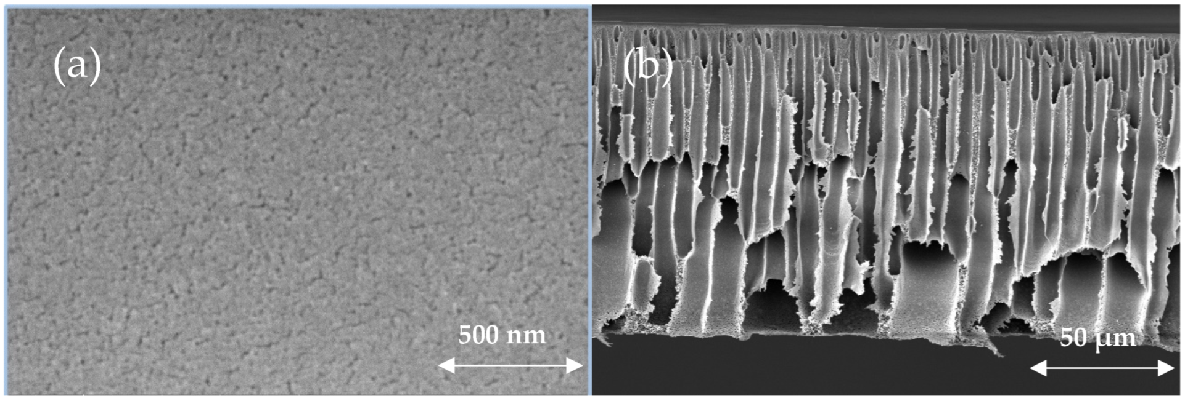
Membrane Types
Commonly polymers, but can be ceramics, metals, carbon, etc. (especially for high temps)
Porous Separation achieved b/c each species has different rate of diffusion through micropores
(1 Å = 0.1 nm = 0.0001 μm)
Microfiltration: 200 - 100,000 Å
Ultrafiltration: 10 - 200 Å
Nanofiltration: 1 - 10 Å
Non-porous Separation achieved b/c species have different solubility in membrane
“For dense, amorphous membranes…..diffusing species must dissolve into the polymer and then diffuse through the polymer between the segments of the macromolecular chains”
a. Henley, E. J.; Seader, J. D.; Roper, D. K. Separation Process Principles, 3rd ed.; Hoboken, N.J. Wiley, 2011.
b. Al Marri, S. H.; Manawi, Y.; Simson, S.; Lawler, J.; Kochkodan, V. Novel Ultrafiltration Polyethersulfone Membranes Blended with Carrageenan. Polymers 2025
Notes:
Cal

Slide 8
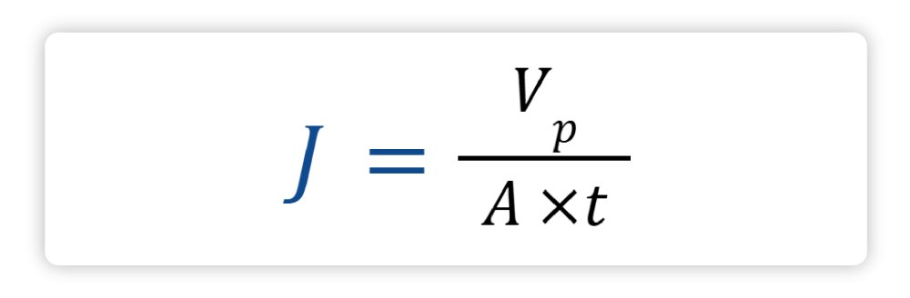
Simulating Microfiltration with Cross Flow Filtration (CFF)
In CFF, the feed stream flows parallel to the surface of the membrane. The flux across the membrane is governed by the following general equation
Can simulate microfiltration through cross flow filtration. This simulates the separation of particles in a fluid using a small membrane.
In a small laboratory setting a permeate volume of 5 L over the course of an hour can be used to simulate microfiltration
In a lab a typical membrane area is about 0.1 m²
J: Permeate flux (LMH)
Vp: Permeate volume (L) which is liquid that flows through the membrane
A: Membrane active area (m²)
t: Time taken to collect the volume (h)
Cross Flow Filtration Method Handbook. https://static.fishersci.eu/content/dam/fishersci/en_EU/suppliers/GE/Cross_Flow_Filtration_Method.pdf.
Notes:
Isabella
Microfiltartion can be used to filter out bacteria from water
Retentate stream can be recircuklated in cross flow and can have in increase in rate of flux

Slide 9
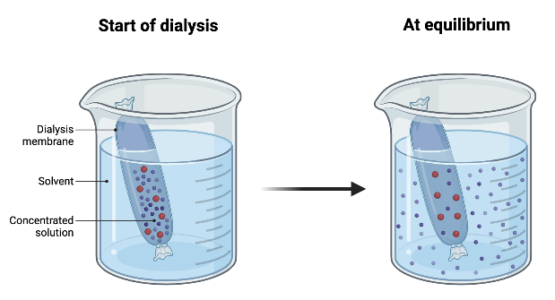


Dialysis
Dialysis is the process of separating colloidal
particles from dissolved ions or small molecules
Diffusion Equation:
Simplified:
Where V is the volume of the vessel, Q is the volumetric flow, A is the surface area of the vessel, J is the flux at the wall of the vessel, v is the velocity of the liquid, D is the diameter of the vessel and R is the radius of the vessel
Lau, K. Dialysis. Chemistry LibreTexts. https://chem.libretexts.org/Bookshelves/Physical_and_Theoretical_Chemistry_Textbook_Maps/Supplemental_Modules_(Physical_and_Theoretical_Chemistry)/Physical_Properties_of_Matter/Solutions_and_Mixtures/Case_Studies/Dialysis.
Notes:
Amanda’s Slide
Developed by Thomas Graham (1861), who also formulated Graham’s Law
Colloid: Substance with particle size between 10⁻⁷ cm and 10⁻³ cm, larger than atoms
Crystalloid: Substance that forms a true solution and can diffuse through a semipermeable membrane via dialysis
Examples of Semipermeable membranes
Parchment
Cellophane

Slide 10
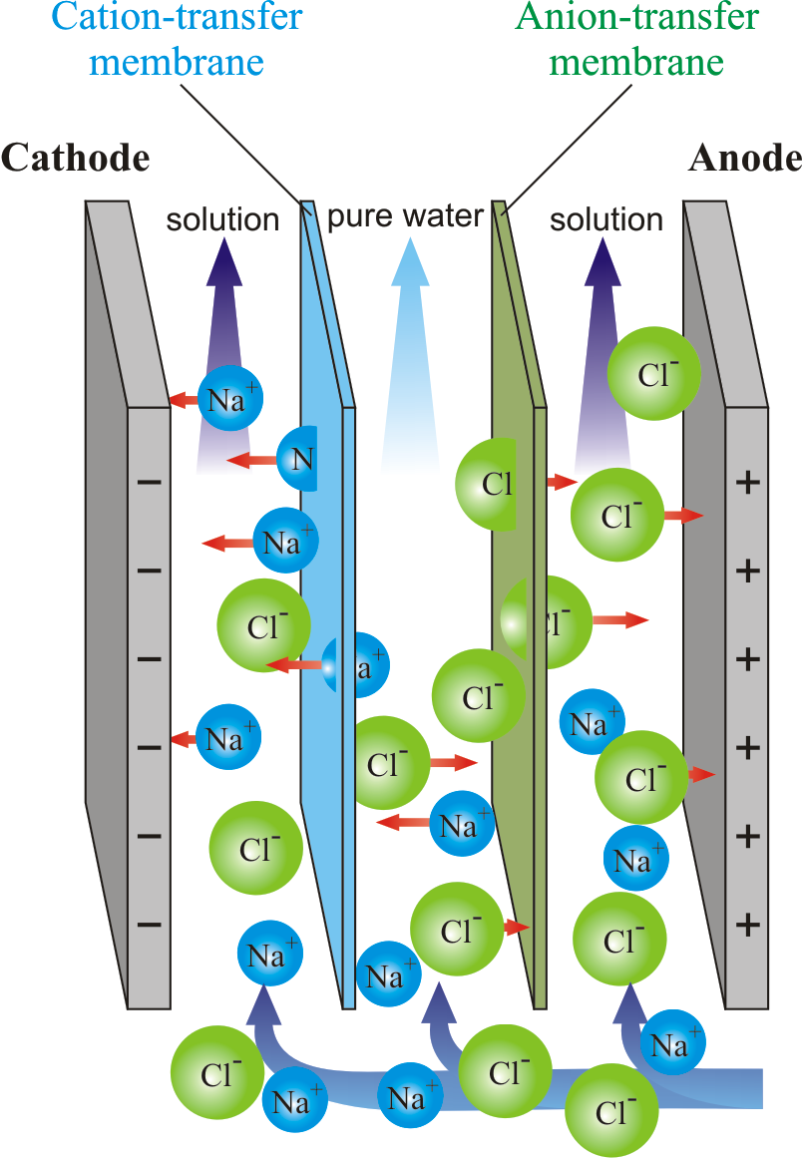
The Rate of Dialysis
Dialysis
Slow process, depends on diffusion rates & particle size
Speeding up dialysis
Heating increases diffusion
Electrodialysis (applies electric field)
Electrodialysis Process
Electrodes places on both sides of the membrane
Enhances separation speed, commonly used in water purification & desalination
Membrane Transfer . ElectroDialysis. (n.d.). https://www.periodni.com/gallery/download_image.php?name=electrodialysis.png
Notes:
Amanda’s Slide
Positive ions move toward the negative electrode, negative ions move toward the positive electrode

Slide 11
Examples of Filtration/Dialysis/Membranes
Filtration - Water/Air Treatment - Remove suspended solids, bacteria, dust, and pollutants
Dialysis - Desalting Proteins - Removal of salts and other small molecules from proteins
Membrane - Gas Separation - Utilizing the different size of molecules to separate them
(OpenAI, personal communication, January 31, 2025)
Notes:
Ryan

Slide 12
Major Differences Between Filtration/Dialysis/Membranes
 | Filtration | Dialysis | Membranes
Driving Force | Pressure/Gravity | Concentration Gradient | Pressure/Concentration Gradient
Transport Type | Passive (Sometimes Active) | Passive and Active | Active
Separation Mechanism | Physical Blocking of Solids | Diffusion Across Membrane | Selective Permeability
Separation Basis | Particle Size | Molecule Size | Molecular Properties/Size
(OpenAI, personal communication, January 31, 2025)
Notes:
Ryan

Slide 13
Questions?

